Slide 1



Support
Hypothesis of finding
SAD
only
Little support
Homogenous environments
S
N
only
Strong support
S_{n}
Diversity
β_{Sn}
agg
only
Moderate support
Modification gradient
Diversity
Homogenous environments
Diversity
Modification gradient
Modification gradient

Slide 2
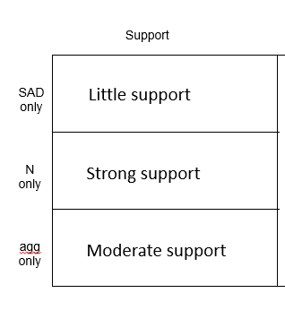
























Heterogenous
environments
Specialists and
generalists
Homogenous
Natural environments
Specialists only
Homogenous urban
environments
Extreme
generalists only
Diversity
Modification gradient

Slide 3
Heterogenous
environments
Specialists and
generalists
Homogenous
Natural environments
Homogenous urban
environments
Extreme
generalists only
Specialists only
Diversity
Modification gradient
Hypothesis | Alpha scale | Gamma scale
SAD | Little support | Moderate support
N | Strong support | Strong support
aggregation | No support | No support

Slide 4
Hypothesis | Alpha scale | Gamma scale
Species abundance distribution | Little support | Moderate support
Number of individuals | Strong support | Strong support
Spatial arrangement of conspecific individuals | No support | No support

Slide 5
Hypothesis | Alpha scale | Gamma scale
Number of individuals | Strong support | Strong support
Species abundance distribution | Little support | Moderate support
Spatial arrangement of conspecific individuals | No support | No support

Slide 6
Weak SAD effect along gradient
Strong N effect along gradient
Moderate agg effect along gradient
Homogenous
Natural environments
Specialists only
Heterogenous
environments
Specialists and
generalists
Homogenous urban
environments
Extreme
generalists only

